Slide 1
Galaxy Zoo
galaxy classification

Slide 2
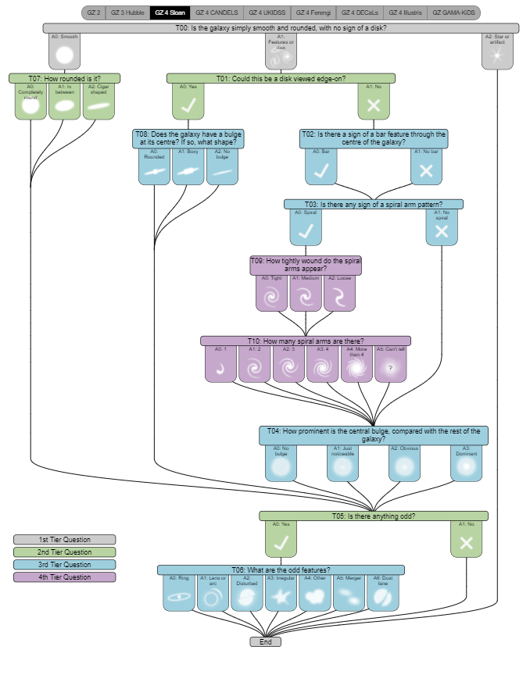
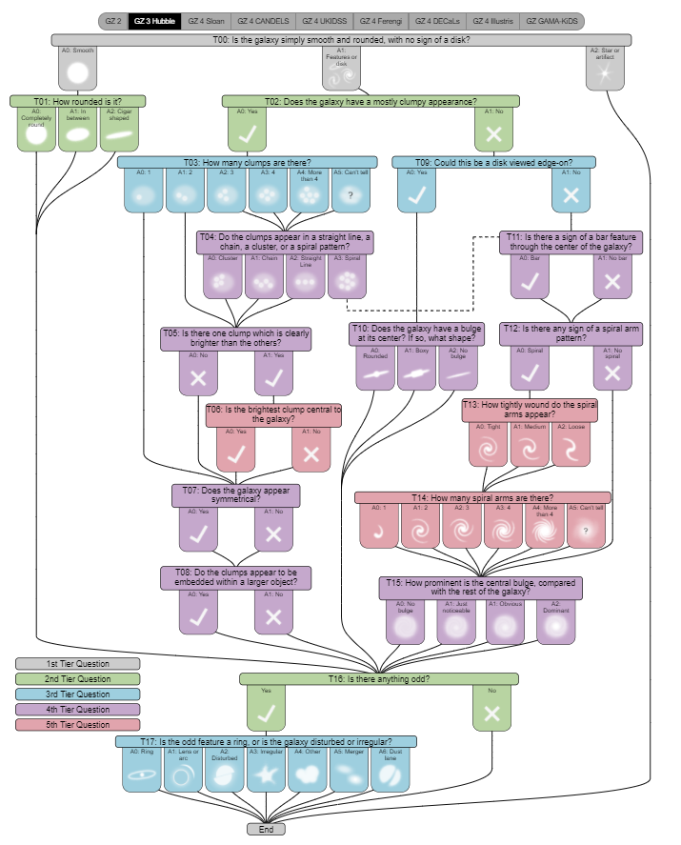
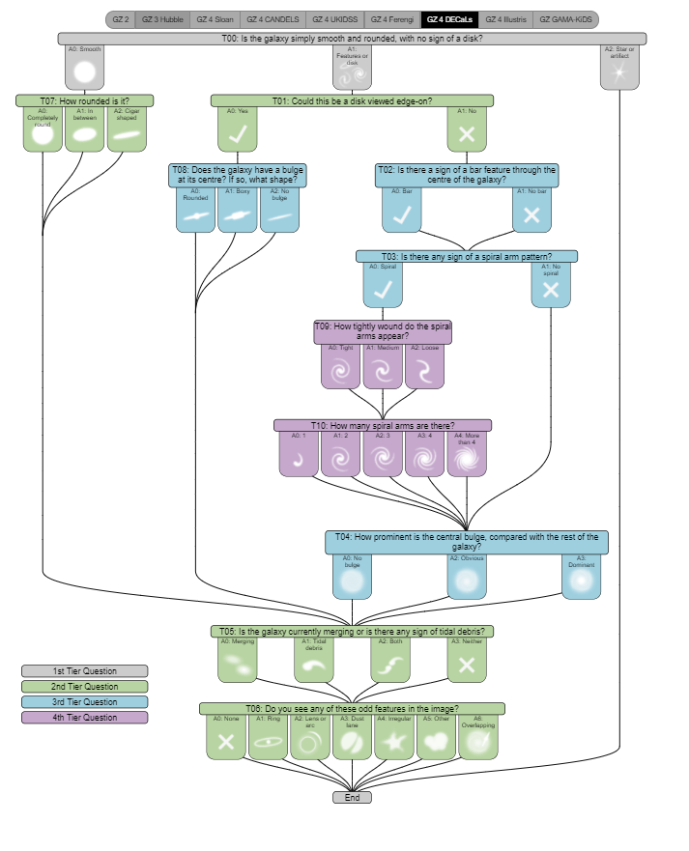
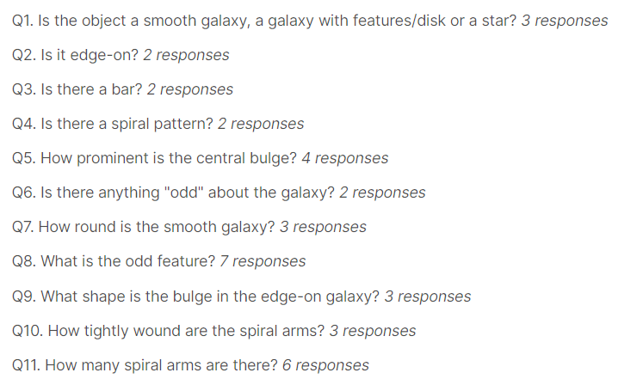
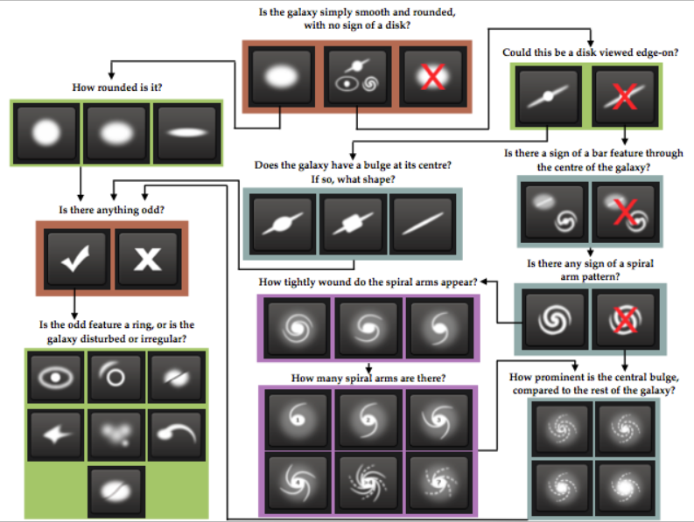
The challenge is to:
recognize the structure of the galaxy
classify galaxies by it’s photo

Slide 3



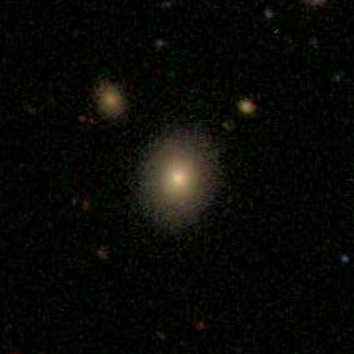
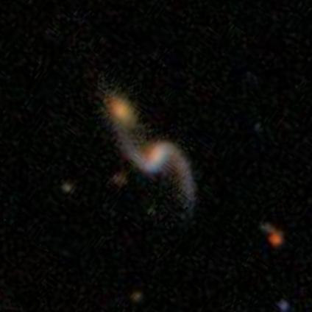
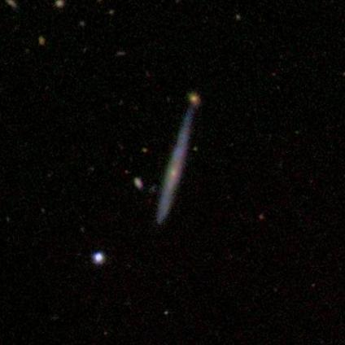
The dataset
Images of the galaxies from open source dataset of Sloan Digital Sky Survey manually labeled by volunteers in Galaxy Zoo project prepared for Kaggle Challenge
more than 60k galaxies images
every photo represents new different galaxy
RBGA jpeg images
424 x 424 pixels

Slide 4
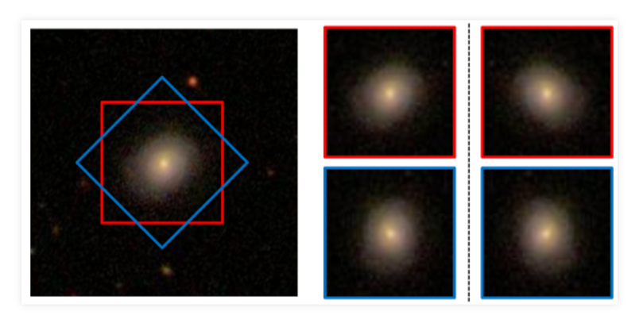
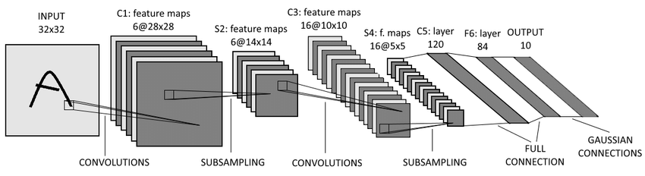
Preprocessing Data
Slicing and using central part of images (direct galaxy) with 96*96 shape (initial shape – 424*424). As a result, reducing amount of computation.
For each sliced image, making three rotated by angle = 90deg duplicates with the same output (idea similar as on the picture but all copies differs by 90deg) to increase number of relevant data.

Slide 5
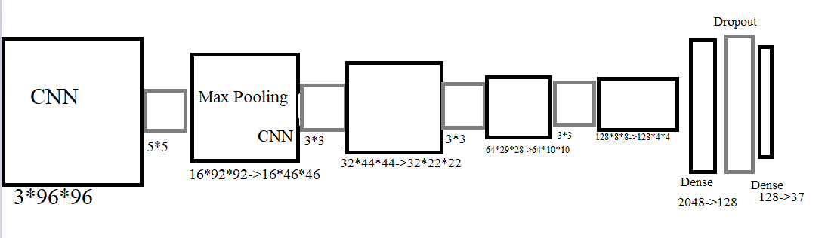
Model
CNN -> Max Pooling (a few times) -> Dense -> Dropout -> Dense (e.g. on the right, but with another dimensions and some layers)

Slide 6
Some thoughts
Large amount of computation
Needed improvements for model

